Slide 1

Enterprise HR Analytics Deep-Dive
A comprehensive, unfiltered workforce diagnostic model profiling the entire corporate footprint of 1,470 employees. Strategic insights extracted from the global dashboard parameters.

Slide 2
Global Workforce Diagnostics
A Dashboard to tackle one of the biggest challenge faced in business employee turn-over.

Slide 3





Global Enterprise Headline Metrics
16.12%
TOTAL EMPLOYEES
TOTAL ATTRITION
1,470
237
ATTRITION RATE
ACTIVE HEADCOUNT
AVERAGE AGE
1,233
37 Yrs

Slide 4
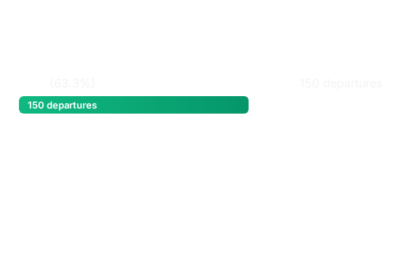

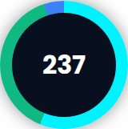

Gender & Departmental Attrition
Attrition by Gender
Department Wise Attrition
R&D: 133 (56.12%)
Sales: 92 (38.82%)
HR: 12 (5.06%)
Attrition continues to run heavily in the male demographic group, making up nearly two-thirds of all departures recorded across the global organization.
Research and development leads corporate turnover at 56.12%, but sales is also a significant concern with 92 departures (38.82%).

Slide 5
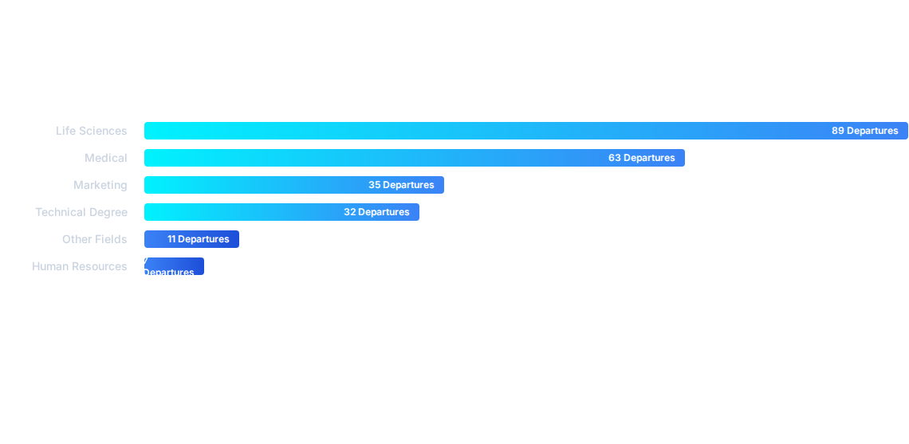
Education Field Wise Attrition
Combined, employees with academic backgrounds in Life Sciences and Medical fields comprise 152 of our 237 total departures, representing an staggering 64.1% of global attrition.

Slide 6
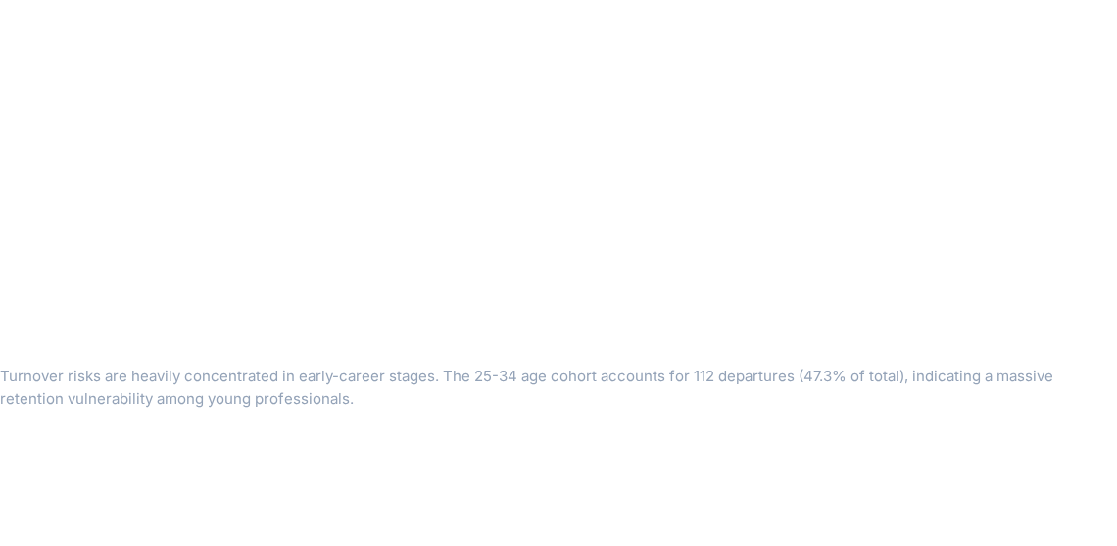



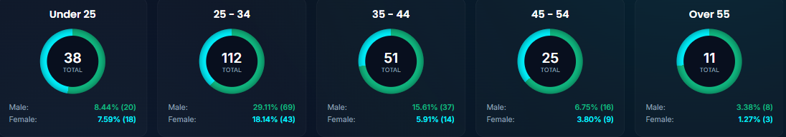










Gender Attrition by Age Group Cohorts
25 - 34
35 - 44
45 - 54
Over 55
Under 25
Male:29.11% (69)
Male:15.61% (37)
Male:6.75% (16)
Male:3.38% (8)
Male:8.44% (20)
Female:18.14% (43)
Female:5.91% (14)
Female:3.80% (9)
Female:1.27% (3)
Female:7.59% (18)

Slide 7
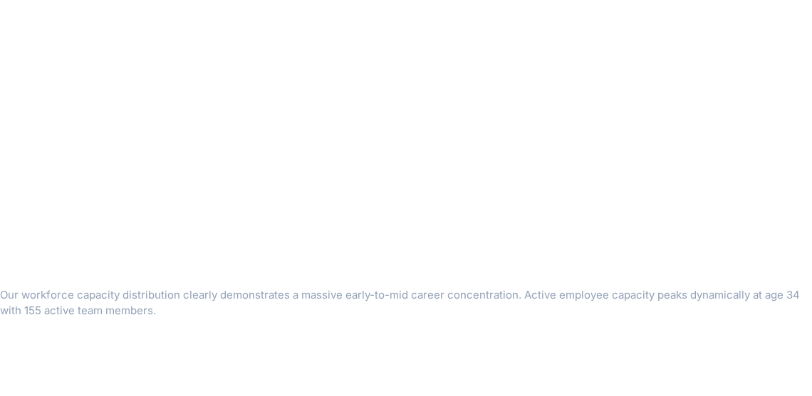
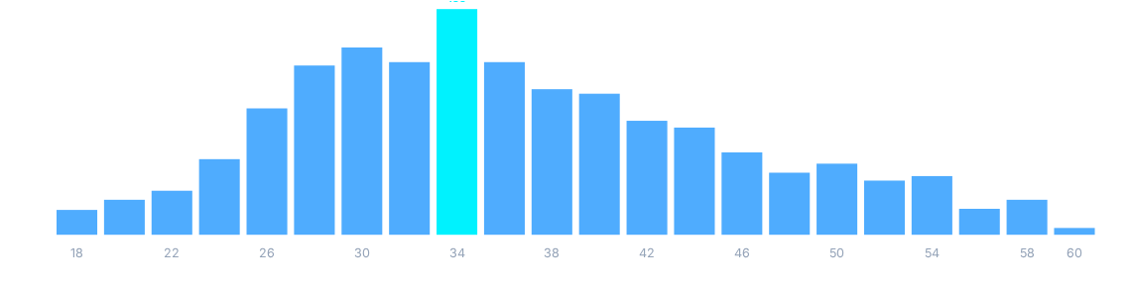
Active Employee Count by Age Group

Slide 8

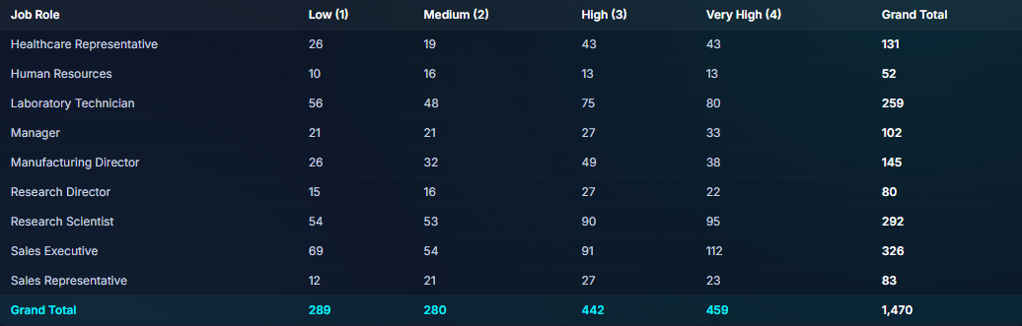
Job Satisfaction Rating by Role
Job Role | Low (1) | Medium (2) | High (3) | Very High (4) | Grand Total
Healthcare Representative | 26 | 19 | 43 | 43 | 131
Human Resources | 10 | 16 | 13 | 13 | 52
Laboratory Technician | 56 | 48 | 75 | 80 | 259
Manager | 21 | 21 | 27 | 33 | 102
Manufacturing Director | 26 | 32 | 49 | 38 | 145
Research Director | 15 | 16 | 27 | 22 | 80
Research Scientist | 54 | 53 | 90 | 95 | 292
Sales Executive | 69 | 54 | 91 | 112 | 326
Sales Representative | 12 | 21 | 27 | 23 | 83
Grand Total | 289 | 280 | 442 | 459 | 1,470
*Complete unfiltered company satisfaction matrix indicating strong satisfaction volumes in Sales Executives and Research Scientists, contrasted with major "Low" rating pockets.

Slide 9
Data-Driven Retention Interventions
Overhaul Early Career Frameworks: With 47.3% of all attrition centered strictly within the 25-34 age cohort (112 departures), introducing proactive career mapping, mentoring, and dynamic rotational pathways is critical.
Targeted Sales Role Interventions: Since R&D Department drive 56.12% of total turnover (133 departures), we must evaluate commission structures, compensation models, and core expectations.
Job Satisfaction Calibration: Address large volume pockets of low satisfaction (Rating '1') within Laboratory Technicians (56 employees) and Research Scientists (54 employees) to prevent secondary turnover risks.
Onboarding Alignment: Build specialized onboarding experiences tailored to Life Sciences (89 departures) and Medical graduates (63 departures), who drive over 64% of educational-profile turnover.

Slide 10
Strategic Implementation Roadmap
Q2: Onboarding Program Restructure
Q4: Evaluation
We will launch our fresh specialized on boarding program for science and medical graduates launch targeted mental wellness audits.
We will check back in with employee satisfaction surveys to prove our changes actually brought our turnover number down.
Q1:WE LISTEN
Q3: Incentive Reform
We listen to the employees to find out exactly why they are leaving
We will fix pay and bonus structure of high stress roles to keep them .

